Slide 1
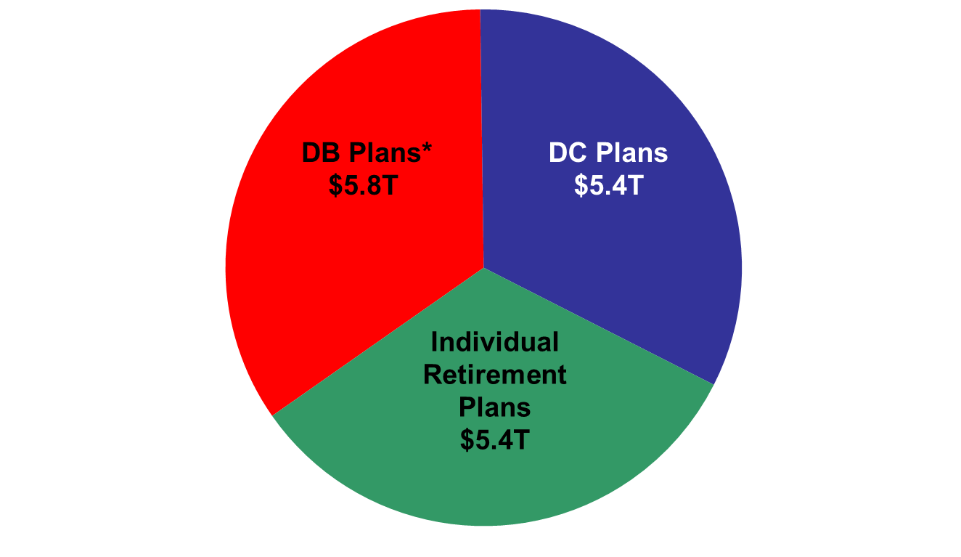
Total Retirement Market = $16.6 Trillion
*Assets of the Federal employee defined benefit plan are excluded
Data as of December 31, 2012
Source: ICI data adjusted

